Slide 1
EMBEDDED DEVICE DRIVER

Slide 2
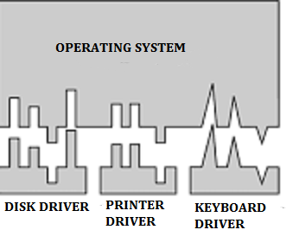
WHAT IS EDD?
The software that directly interfaces with and controls the hardware is called a device driver.

Slide 3
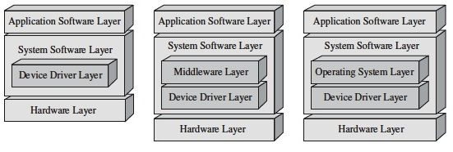
All embedded systems that require software have, at the very least, device driver software in their system software layer.

Slide 4
EDD Classification
EDD
Architecture Specific
e.g. On-Chip memory, MMU etc
Generic
e.g. OFF-Chip memory, I/o..etc

Slide 5
General EDD functions…
H/W startup
Shutdown
Disable and Enable
Acquire and Release
READ/WRITE
Install/Unistall

Slide 6
These functions are based on S/Ws perception of the H/w.
H/W is assumed to be in any of the 3 states at a given time.
Inactive , busy or finished.
INACTIVE state : H/w is disconnected (Install function) or Without power (Initialization routine) or Disabled (Enable routine).
Busy state: H/w might be processing data (Release mechanism)
Finished state : It’s active and allows read/write requests.

Slide 7
Concurrency and Race condition
Linux kernel is pre-emptible and our driver code can loose the processor at any time, and the process that replace could be running our driver code.
(design considers code to be rentrant)
E.g. use Semaphores,Mutexes
Spin locks

Slide 8
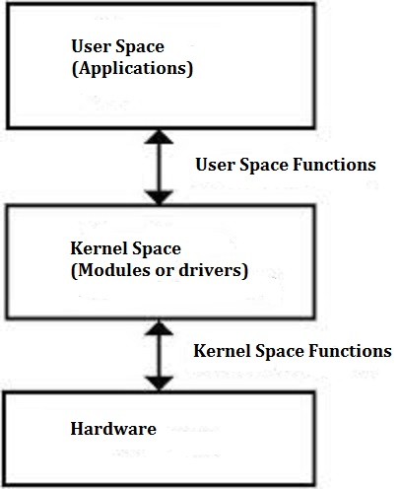
Writing DD in Linux
For each function in user space ,there exists an equivalent in kernel space (allowing the transfer of information from the kernel to the user and vice-versa)

Slide 9
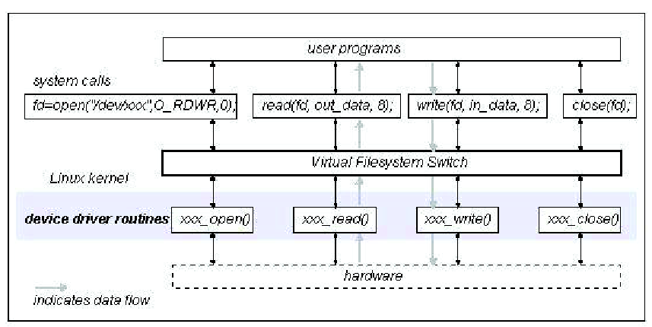
User Process and Kernel

Slide 10
Function example
Loading module:
insmod /* User space command*/
module_init() /* Kernel space function */)
{ ..k1;k2;k3;.. }
Remove module:
rmmod;
module_exit()
{ ..k1;k2;k3;.. }

Slide 11
Opening device:
fopen(int fd, const char *mode);
xxx_open(struct inode *inode, struct file *filp);
4. Closing device:
fclose(FILE *fp);
xxx_release(struct inode *inode, struct file *filp)

Slide 12
5. Reading device:
fread();
xxx_read(struct file *filp, char *buf, size_t count, loff_t *f_pos);
6. Write to device
fwrite();
xxx_write( struct file *filp, char *buf, size_t count, loff_t *f_pos)

Slide 13
References
Linux Device Drivers 3rd Edition by Jonathan Corbet, Alessandro Rubini & Greg Kroah, O'Reilly Publishers
Embedded Systems Architecture, 1st Edition,A Comprehensive Guide for Engineers and Programmers.Author: T.Neorgaard

